Slide 1
Descriptive Statistics
for
Data Science

Slide 2
Outline
Introduction to Statistics
Two Parts of Statistics
Descriptive Statistics
Distribution of Data
Measures of Central Location
Measures of Dispersion
Normal Distribution
Covariance and Correlation

Slide 3
Introduction
Statistics involves systematic way of collecting, organising and analysing data
Statistics is used in a variety of fields and in an inherent part of data science
Probability and Statistics are together used in data science to make conclusions about data and on models built using data
Motivation through Example:
What is the time that you would take to go from your home to office/college?
Time taken varies from day-to-day depending on many factors
Some factors may be deterministic – like the distance travelled, speed of travel
Some factors may be random – like traffic conditions, an accident, a road block
Therefore, time taken is a random variable which taken different values
However, we can still answer this question as a single number or range using statistical concepts

Slide 4
Two Parts of Statistics
Descriptive Statistics:
Describes the characteristics of a dataset
Following can be used to understand, summarise and describe the data:
Distribution of data
Measures of Central location of data
Measures of Dispersion/Variability of data
Inferential Statistics:
To make inferences or predictions about data which is not fully available or is too large to analyse
Making predictions about the population set using a sample set of data in combination with probability

Slide 5
Types of Variables
Numerical Variables: Variables which can be measured and placed in ascending or descending order
Continuous variables: Numerical variables which can take continuous values
Eg. Person’s height, weight, etc.
Discrete variables: Numerical variables which can take discretised values as such binary numbers, integers, whole numbers or any other discretisation
Eg. Pages in a book, count of objects
Categorical Variables: Variables that can be sorted into categories or groups
Ordinal variables: They can be ordered or ranked according to a scale but not measured
Eg. levels of temp (cold, warm, hot)
Nominal variables: Variables with assigned labels having no quantitive value
Eg. Gender, Colours, Place, etc.

Slide 6
Descriptive Statistics - Univariate

Slide 7
Descriptive Statistics - Univariate
Involves defining characteristics for any single variable of a dataset
Following are important characteristics:
Distribution – Describes the shape of the data in terms of frequency
Measures of Central location – Describe the central or focal point of the data
Measures of Dispersion/Variability – Describes the spread of the data

Slide 8
Distribution of Data

Slide 9
Distribution of data
Sample # | Hrs | Sample # | Hrs | Sample # | Hrs
1 | 55 | 11 | 45 | 21 | 39
2 | 46 | 12 | 50 | 22 | 52
3 | 52 | 13 | 68 | 23 | 33
4 | 51 | 14 | 54 | 24 | 51
5 | 48 | 15 | 46 | 25 | 54
6 | 50 | 16 | 48 | 26 | 59
7 | 27 | 17 | 47 | 27 | 42
8 | 53 | 18 | 44 | 28 | 49
9 | 57 | 19 | 49 | 29 | 56
10 | 50 | 20 | 62 | 30 | 53
Describes the shape of the data in terms of frequency
Frequency refers to how many times a particular value occurs in the data for a particular variable
Example: Consider a dataset capturing number of hours battery of a mobile lasted (30 samples i.e., 30 batteries)
Frequency for each value of data is computed
Frequency table
Hrs | Frequency | Hrs | Frequency | Hrs | Frequency | Hrs | Frequency
X | f | X | f | X | f | X | f
68 | 1 | 57 | 1 | 46 | 2 | 35 | 0
67 | 0 | 56 | 1 | 45 | 1 | 34 | 0
66 | 0 | 55 | 1 | 44 | 1 | 33 | 1
65 | 0 | 54 | 2 | 43 | 0 | 32 | 0
64 | 0 | 53 | 2 | 42 | 1 | 31 | 0
63 | 0 | 52 | 2 | 41 | 0 | 30 | 0
62 | 1 | 51 | 2 | 40 | 0 | 29 | 0
61 | 0 | 50 | 3 | 39 | 1 | 28 | 0
60 | 0 | 49 | 2 | 38 | 0 | 27 | 1
59 | 1 | 48 | 2 | 37 | 0
58 | 0 | 47 | 1 | 36 | 0

Slide 10
Frequency Distribution Plot
Frequency Polygon

Slide 11
Grouped Frequency Distribution
Motivation: Number of values that a variable taken could very high (infinite if continuous variable)
Therefore, for numerical variables, values are grouped and frequency is computed
Frequency table
Grouped Frequency table
Hrs | Frequency | Hrs | Frequency | Hrs | Frequency | Hrs | Frequency
X | f | X | f | X | f | X | f
68 | 1 | 57 | 1 | 46 | 2 | 35 | 0
67 | 0 | 56 | 1 | 45 | 1 | 34 | 0
66 | 0 | 55 | 1 | 44 | 1 | 33 | 1
65 | 0 | 54 | 2 | 43 | 0 | 32 | 0
64 | 0 | 53 | 2 | 42 | 1 | 31 | 0
63 | 0 | 52 | 2 | 41 | 0 | 30 | 0
62 | 1 | 51 | 2 | 40 | 0 | 29 | 0
61 | 0 | 50 | 3 | 39 | 1 | 28 | 0
60 | 0 | 49 | 2 | 38 | 0 | 27 | 1
59 | 1 | 48 | 2 | 37 | 0
58 | 0 | 47 | 1 | 36 | 0
Hrs grouping | Frequency
66 - 68 | 1
63 - 65 | 0
60 - 62 | 1
57 - 59 | 2
54 - 56 | 4
51 - 53 | 6
48 - 50 | 7
45 - 47 | 4
42 -44 | 2
39 - 41 | 1
36 -38 | 0
33 – 35 | 1
30 – 32 | 0
27 – 29 | 1
Total | 30

Slide 12
Grouped Frequency Distribution
Grouped frequency table is not unique as groupings can be made in different ways
Recommendations for Grouping:
Interval size should remain the same i.e., number of variable values in each group should be same
Number of groups should not exceed 10 as it becomes difficult to comprehend
Frequency table
Hrs | Frequency | Hrs | Frequency | Hrs | Frequency | Hrs | Frequency
X | f | X | f | X | f | X | f
68 | 1 | 57 | 1 | 46 | 2 | 35 | 0
67 | 0 | 56 | 1 | 45 | 1 | 34 | 0
66 | 0 | 55 | 1 | 44 | 1 | 33 | 1
65 | 0 | 54 | 2 | 43 | 0 | 32 | 0
64 | 0 | 53 | 2 | 42 | 1 | 31 | 0
63 | 0 | 52 | 2 | 41 | 0 | 30 | 0
62 | 1 | 51 | 2 | 40 | 0 | 29 | 0
61 | 0 | 50 | 3 | 39 | 1 | 28 | 0
60 | 0 | 49 | 2 | 38 | 0 | 27 | 1
59 | 1 | 48 | 2 | 37 | 0
58 | 0 | 47 | 1 | 36 | 0
Grouped Frequency table
Hrs | Frequency
63 - 68 | 1
57 - 62 | 3
51 - 56 | 10
45 - 50 | 11
39 - 44 | 3
33 - 38 | 1
27 - 32 | 1

Slide 13
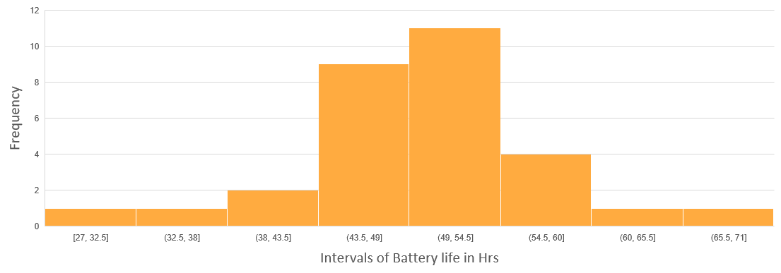
Histogram
Histogram is the plot of grouped frequency distribution
A bar graph in which grouping intervals are on x-axis and frequency values on y-axis

Slide 14
Frequency to Probability Distribution
Frequencies are to converted to proportions to get probability values
Hrs | Frequency
66 - 68 | 1
63 - 65 | 0
60 - 62 | 1
57 - 59 | 2
54 - 56 | 4
51 - 53 | 6
48 - 50 | 7
45 - 47 | 4
42 -44 | 2
39 - 41 | 1
36 -38 | 0
33 - 35 | 1
30 - 32 | 0
27 - 29 | 1
Total n | 30
Hrs | Frequency | Proportion
66 - 68 | 1 | 0.03
63 - 65 | 0 | 0.00
60 - 62 | 1 | 0.03
57 - 59 | 2 | 0.07
54 - 56 | 4 | 0.13
51 - 53 | 6 | 0.20
48 - 50 | 7 | 0.23
45 - 47 | 4 | 0.13
42 -44 | 2 | 0.07
39 - 41 | 1 | 0.03
36 -38 | 0 | 0.00
33 - 35 | 1 | 0.03
30 - 32 | 0 | 0.00
27 - 29 | 1 | 0.03
Total n | 30 | 1.00

Slide 15
Distribution of data – Categorical Variable
Example: Consider a dataset capturing most liked sport of 30 different persons
Frequency table
Sample # | Sport | Sample # | Hrs | Sample # | Sport
1 | Cricket | 11 | Cricket | 21 | Cricket
2 | Hockey | 12 | Football | 22 | Football
3 | Football | 13 | Cricket | 23 | Cricket
4 | Cricket | 14 | Hockey | 24 | Hockey
5 | Cricket | 15 | Cricket | 25 | Hockey
6 | Hockey | 16 | Football | 26 | Cricket
7 | Cricket | 17 | Hockey | 27 | Hockey
8 | Football | 18 | Cricket | 28 | Football
9 | Hockey | 19 | Football | 29 | Cricket
10 | Cricket | 20 | Cricket | 30 | Football
Category | Frequency
Cricket | 15
Hockey | 8
Football | 7

Slide 16
Measures of Central Location

Slide 17
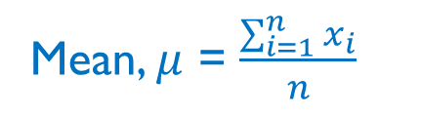
Measures of Central Location
Describe the central or focal point of the data
Three measures of centrality: Mean, median and mode
These measures are used to make some useful interpretations about the data
Mean: Sum of the sample values of a numerical variable divided by the number of samples
Eg: Consider the data pertaining to battery life of different mobiles
Sample # | Hrs | Sample # | Hrs | Sample # | Hrs
1 | 41 | 11 | 45 | 21 | 40
2 | 24 | 12 | 50 | 22 | 48
3 | 48 | 13 | 42 | 23 | 33
4 | 49 | 14 | 44 | 24 | 35
5 | 48 | 15 | 46 | 25 | 42
6 | 50 | 16 | 48 | 26 | 43
7 | 48 | 17 | 47 | 27 | 45
8 | 44 | 18 | 48 | 28 | 47
9 | 48 | 19 | 49 | 29 | 48
10 | 50 | 20 | 44 | 30 | 35
Mean, $μ$ = $\frac{\sum_{i=1}^{n}{x_{i}}}{n}$
Mean Battery Life = 44.3

Slide 18

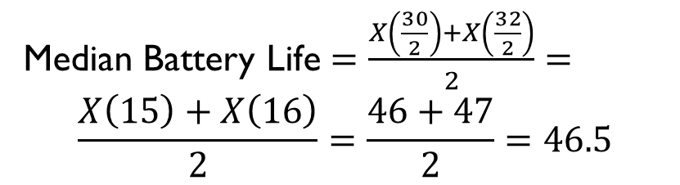
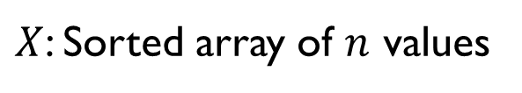

Measures of Central Location - Median
Median: Divides the total number of samples into two halves (sorted in ascending order) and takes the middle value
For even number of samples, average of two middle values is taken as median
Sorted Data of Battery Life $(n=30)$
$X$: Sorted array of $n$ values
Sample # | Hrs | Sample # | Hrs | Sample # | Hrs
1 | 24 | 11 | 44 | 21 | 48
2 | 33 | 12 | 44 | 22 | 48
3 | 35 | 13 | 45 | 23 | 48
4 | 35 | 14 | 45 | 24 | 48
5 | 40 | 15 | 46 | 25 | 48
6 | 41 | 16 | 47 | 26 | 49
7 | 42 | 17 | 47 | 27 | 49
8 | 42 | 18 | 48 | 28 | 50
9 | 43 | 19 | 48 | 29 | 50
10 | 44 | 20 | 48 | 30 | 50
Median = $X\left[\frac{n+1}{2}\right]$ if $n$ is odd
= $\frac{X\left[\frac{n}{2}\right]+X\left[\frac{n+2}{2}\right]}{2}$ if $n$ is even
Median Battery Life $=\frac{X\left(\frac{30}{2}\right)+X\left(\frac{32}{2}\right)}{2}=$
$$\frac{X\left(15\right)+X\left(16\right)}{2}=\frac{46+47}{2}=46.5$$

Slide 19
Measures of Central Location - Mode
Mode: Most frequently occurring value in a set of data
Mode can be easily observed from the frequency table
Dataset has no mode if no value repeats
Dataset can also have multiple modes if two (bimodal) or more (multi-modal) values have highest frequency
Frequency table of Battery Life
Value | Frequency | Value | Frequency
24 | 1 | 47 | 2
33 | 1 | 48 | 8
35 | 2 | 49 | 2
40 | 1 | 50 | 3
41 | 1
42 | 2
43 | 1
44 | 3
45 | 2
46 | 1
Mode of Battery Life = 48

Slide 20
Mean, Median, Mode – When to Use
Depending on Type of variable:
Continuous variable – Mean or Median
Discrete variable – Mean or Median
Categorical variable – Mode or Median (only for ordinal variable)
Depending on outliers:
Mean is sensitive to outliers while median and mode are not
Median represents centrality better when there are outliers in the data
Eg: Average value of 3 BHK property in Mumbai – Median is more indicative than mean
Depending on the shape of distribution: To be discussed later
Known Relation: Mode = 3(Median)-2(Mean)

Slide 21
Measures of Dispersion/Variability

Slide 22
Measures of Dispersion/Variability
Motivation through Example:
Dataset 1 : 2, 6, 10, 10, 14,18
Dataset 2 : 1, 2, 10, 10, 18,19
Dataset 3 : 10,10,10,10,10,10
Conclusion: Mean, median, mode do not characterise a data completely, especially they do not capture the variability
Measures of Dispersion describe the spread of the data
In other words, how similar or varied are the set of values in the data
Measures of dispersion:
Range and Interquartile range
Standard Deviation and Variance
Coefficient of Deviation
Coefficient of Skewness
→ Mean =10, Median =10, Mode =10
→ Mean =10, Median =10, Mode =10
→ Mean =10, Median =10, Mode =10

Slide 23
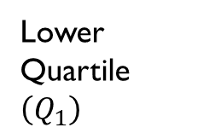
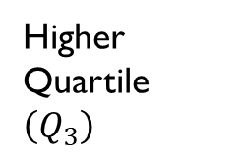
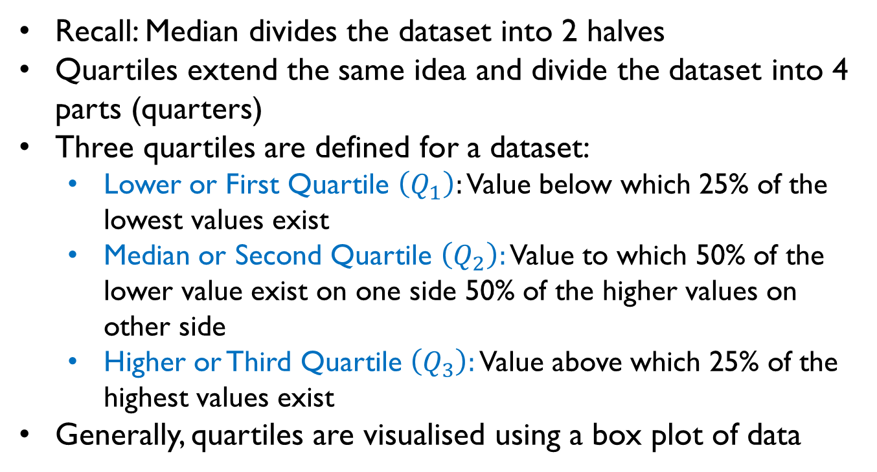



Quartiles
Recall: Median divides the dataset into 2 halves
Quartiles extend the same idea and divide the dataset into 4 parts (quarters)
Three quartiles are defined for a dataset:
Lower or First Quartile $\left(Q_{1}\right):$ Value below which 25% of the lowest values exist
Median or Second Quartile $\left(Q_{2}\right):$ Value to which 50% of the lower value exist on one side 50% of the higher values on other side
Higher or Third Quartile $\left(Q_{3}\right):$ Value above which 25% of the highest values exist
Generally, quartiles are visualised using a box plot of data
Max $(Q_{4})$
Higher Quartile $\left(Q_{3}\right)$
Median $\left(Q_{2}\right)$
Lower Quartile $\left(Q_{1}\right)$
Min $(Q_{0})$

Slide 24
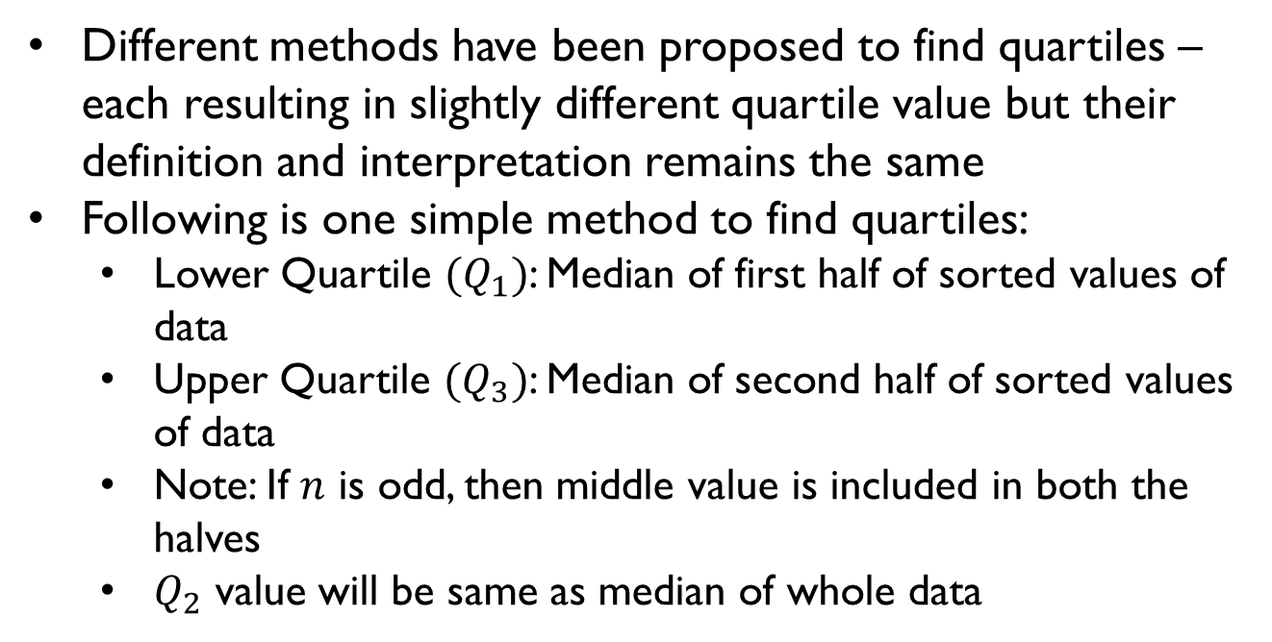
Computation of Quartiles – An Approach
Max $(Q_{4})$
Different methods have been proposed to find quartiles – each resulting in slightly different quartile value but their definition and interpretation remains the same
Following is one simple method to find quartiles:
Lower Quartile $(Q_{1})$: Median of first half of sorted values of data
Upper Quartile $(Q_{3})$: Median of second half of sorted values of data
Note: If $n$ is odd, then middle value is included in both the halves
$Q_{2}$ value will be same as median of whole data
Higher Quartile $\left(Q_{3}\right)$
Median $\left(Q_{2}\right)$
Lower Quartile $\left(Q_{1}\right)$
Min $(Q_{0})$

Slide 25
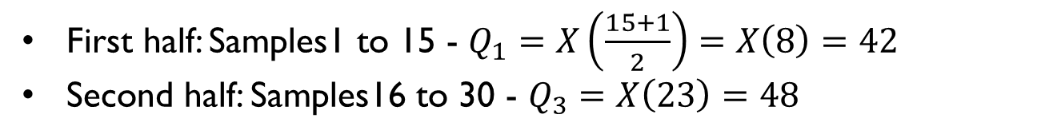
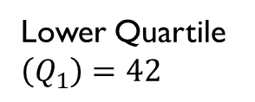
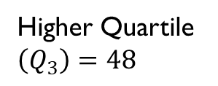
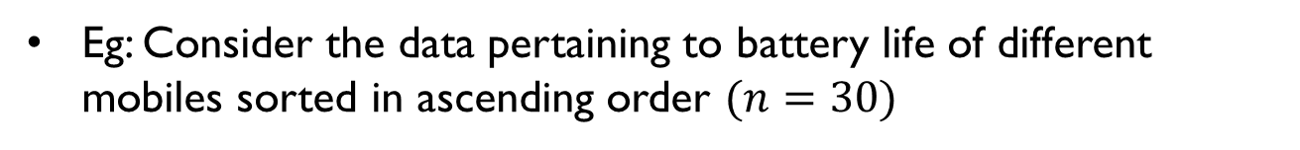



Computation of Quartiles – Example 1
Eg: Consider the data pertaining to battery life of different mobiles sorted in ascending order $(n=30)$
Max $(Q_{4})=50$
Sample # | Hrs | Sample # | Hrs | Sample # | Hrs
1 | 24 | 11 | 44 | 21 | 48
2 | 33 | 12 | 44 | 22 | 48
3 | 35 | 13 | 45 | 23 | 48
4 | 35 | 14 | 45 | 24 | 48
5 | 40 | 15 | 46 | 25 | 48
6 | 41 | 16 | 47 | 26 | 49
7 | 42 | 17 | 47 | 27 | 49
8 | 42 | 18 | 48 | 28 | 50
9 | 43 | 19 | 48 | 29 | 50
10 | 44 | 20 | 48 | 30 | 50
Higher Quartile $\left(Q_{3}\right)=48$
Median $\left(Q_{2}\right)=46.5$
Lower Quartile $\left(Q_{1}\right)=42$
First half: Samples1 to 15 - $Q_{1}=X\left(\frac{15+1}{2}\right)=X\left(8\right)=42$
Second half: Samples16 to 30 - $Q_{3}=X\left(23\right)=48$
Min $(Q_{0})=24$

Slide 26
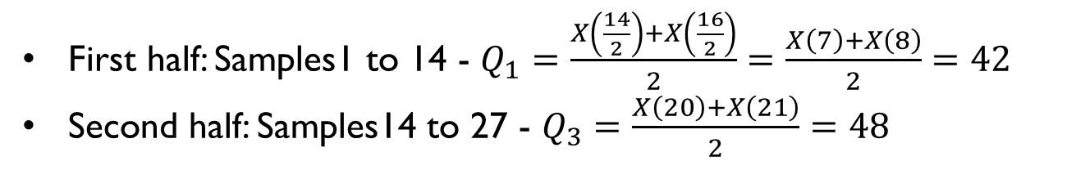
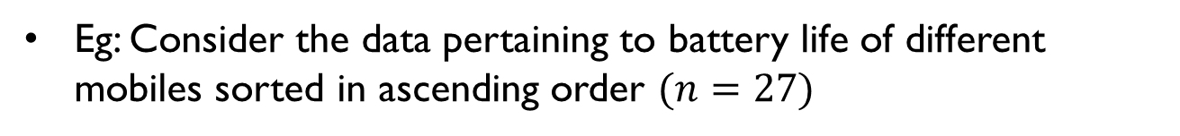
Computation of Quartiles – Example 2
Eg: Consider the data pertaining to battery life of different mobiles sorted in ascending order $(n=27)$
Max $(Q_{4})=50$
Sample # | Hrs | Sample # | Hrs | Sample # | Hrs
1 | 24 | 11 | 44 | 21 | 48
2 | 33 | 12 | 44 | 22 | 48
3 | 35 | 13 | 45 | 23 | 48
4 | 35 | 14 | 45 | 24 | 48
5 | 40 | 15 | 46 | 25 | 48
6 | 41 | 16 | 47 | 26 | 49
7 | 42 | 17 | 47 | 27 | 49
8 | 42 | 18 | 48
9 | 43 | 19 | 48
10 | 44 | 20 | 48
Higher Quartile $\left(Q_{3}\right)=48$
Median $\left(Q_{2}\right)=46.5$
Lower Quartile $\left(Q_{1}\right)=42$
First half: Samples1 to 14 - $Q_{1}=\frac{X\left(\frac{14}{2}\right)+X\left(\frac{16}{2}\right)}{2}=\frac{X\left(7\right)+X\left(8\right)}{2}=42$
Second half: Samples14 to 27 - $Q_{3}=\frac{X\left(20\right)+X\left(21\right)}{2}=48$
Min $(Q_{0})=24$

Slide 27

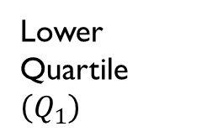
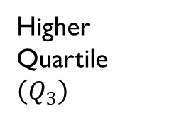
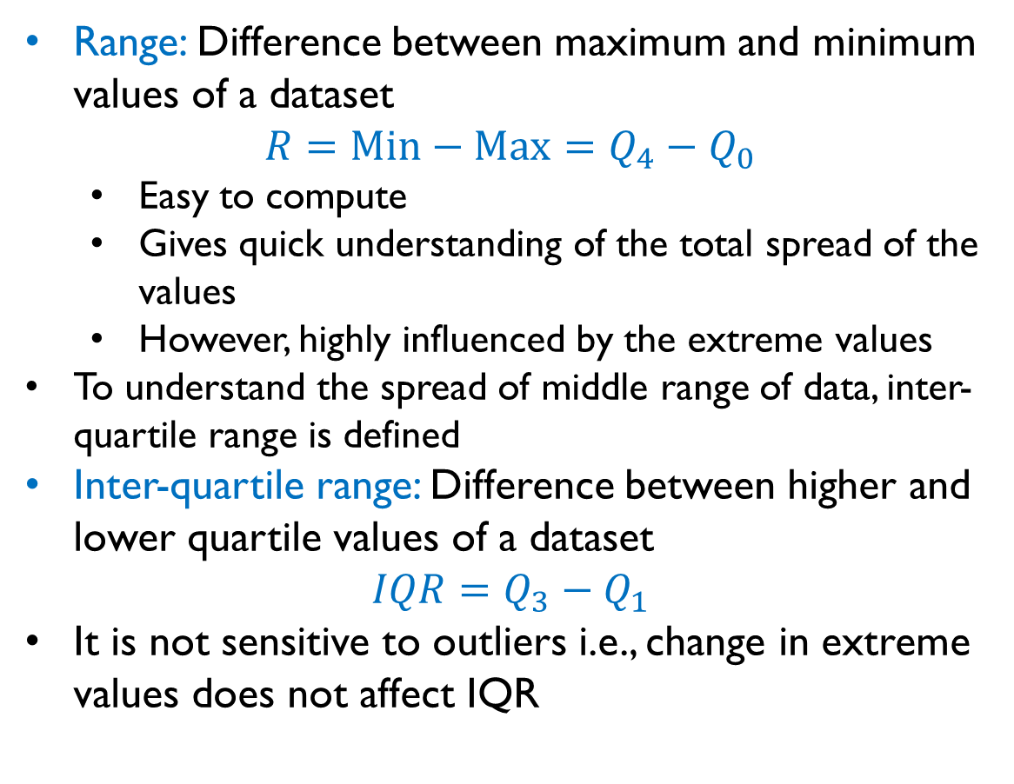




Range and Inter-Quartile Range
Range: Difference between maximum and minimum values of a dataset
$R=Min−Max=Q_{4}−Q_{0}$
Easy to compute
Gives quick understanding of the total spread of the values
However, highly influenced by the extreme values
To understand the spread of middle range of data, inter-quartile range is defined
Inter-quartile range: Difference between higher and lower quartile values of a dataset
$$IQR=Q_{3}−Q_{1}$$
It is not sensitive to outliers i.e., change in extreme values does not affect IQR
Max $(Q_{4})$
Higher Quartile $\left(Q_{3}\right)$
$$R$$
$$IQR$$
Median $\left(Q_{2}\right)$
Lower Quartile $\left(Q_{1}\right)$
Min $(Q_{0})$

Slide 28
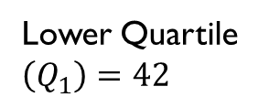
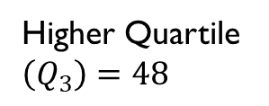
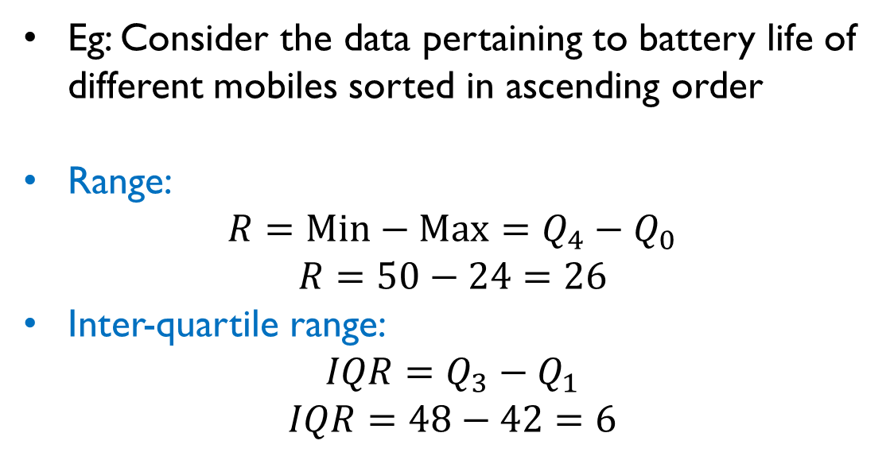



Range and Inter-Quartile Range: Example 1
Eg: Consider the data pertaining to battery life of different mobiles sorted in ascending order
Range:
$R=Min−Max=Q_{4}−Q_{0}$
$$R=50−24=26$$
Inter-quartile range:
$$IQR=Q_{3}−Q_{1}$$
$$IQR=48−42=6$$
Max $(Q_{4})=50$
Higher Quartile $\left(Q_{3}\right)=48$
Median $\left(Q_{2}\right)=46.5$
Lower Quartile $\left(Q_{1}\right)=42$
Min $(Q_{0})=24$

Slide 29
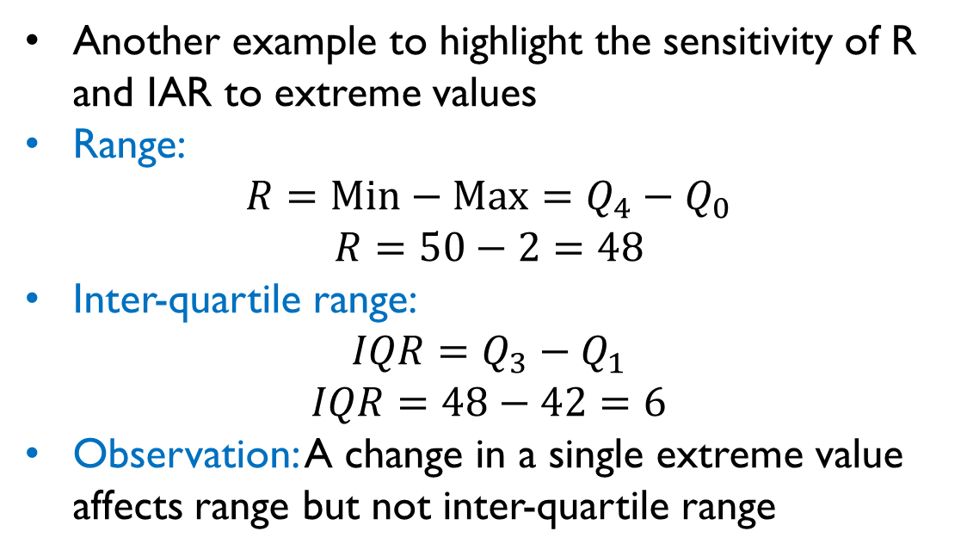

Range and Inter-Quartile Range: Example 2
Max $(Q_{4})=50$
Another example to highlight the sensitivity of R and IAR to extreme values
Range:
$R=Min−Max=Q_{4}−Q_{0}$
$$R=50−2=48$$
Inter-quartile range:
$$IQR=Q_{3}−Q_{1}$$
$$IQR=48−42=6$$
Observation: A change in a single extreme value affects range but not inter-quartile range
Higher Quartile $\left(Q_{3}\right)=48$
Median $\left(Q_{2}\right)=46.5$
Lower Quartile $\left(Q_{1}\right)=42$
Min $(Q_{0})=2$

Slide 30
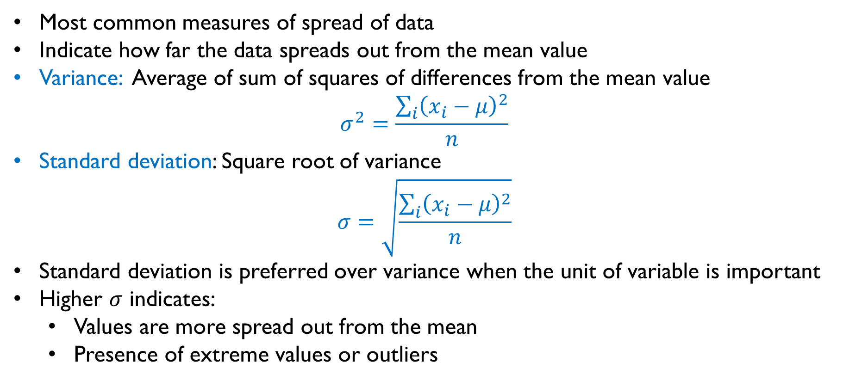
Standard Deviation and Variance
Most common measures of spread of data
Indicate how far the data spreads out from the mean value
Variance: Average of sum of squares of differences from the mean value
$$σ^{2}=\frac{\sum_{i}{{\left(x_{i}−μ\right)}^{2}}}{n}$$
Standard deviation: Square root of variance
$$σ=\sqrt{\frac{\sum_{i}{{\left(x_{i}−μ\right)}^{2}}}{n}}$$
Standard deviation is preferred over variance when the unit of variable is important
Higher $σ$ indicates:
Values are more spread out from the mean
Presence of extreme values or outliers

Slide 31
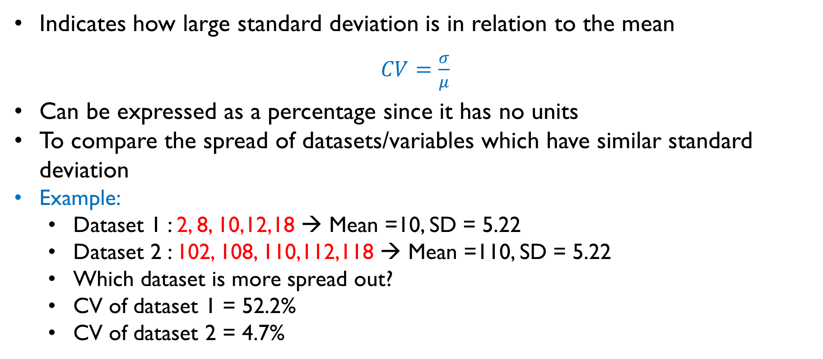
Coefficient of Variation (CV)
Indicates how large standard deviation is in relation to the mean
$CV=\frac{σ}{μ}$
Can be expressed as a percentage since it has no units
To compare the spread of datasets/variables which have similar standard deviation
Example:
Dataset 1 : 2, 8, 10,12,18 → Mean =10, SD = 5.22
Dataset 2 : 102, 108, 110,112,118 → Mean =110, SD = 5.22
Which dataset is more spread out?
CV of dataset 1 = 52.2%
CV of dataset 2 = 4.7%

Slide 32
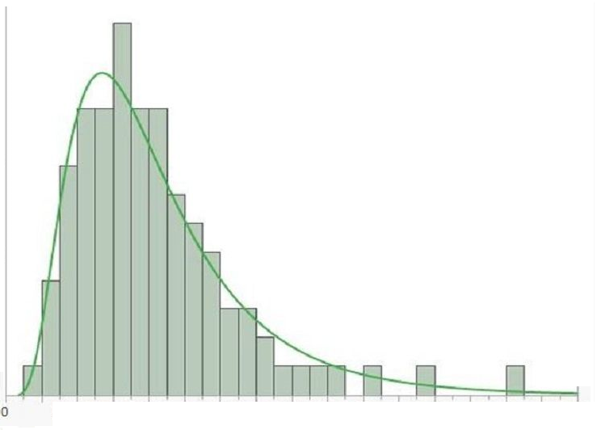
Skewness of a Distribution
Three types of skewness based on the shape of the data (histogram):
Right skewed (Positively skewed): Histogram with shorter bins on right and taller bins on the left i.e., distribution has a tail on the right
Mode<Median<Mean
Eg: Distribution of incomes of individuals
Most individuals earn in a small range on
the left and there is long tail of individuals
on the right who earn much more
Eg: Total number of tickets sold for
different movie
Mode
Median
Mean

Slide 33
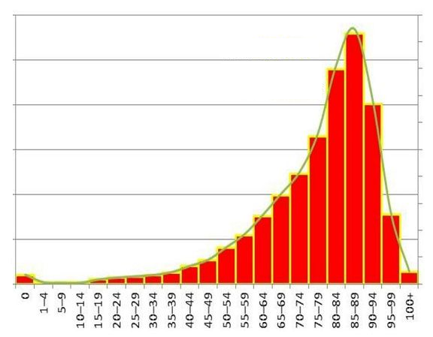
Skewness of a Distribution
Three types of skewness based on the shape of the data (histogram):
Right skewed (Positively skewed): Histogram with shorter bins on right and taller bins on the left i.e., distribution has a tail on the right
Mode<Median<Mean
Left skewed (Negatively skewed): Histogram with shorter bins on left and taller bins on the right i.e., distribution has a tail on the left
Mode>Median>Mean
Eg: Human life cycle
Mode
Median
Mean

Slide 34
Skewness of a Distribution
Three types of skewness based on the shape of the data (histogram):
Right skewed (Positively skewed): Histogram with shorter bins on right and taller bins on the left i.e., distribution has a tail on the right
Mode>Median>Mean
Left skewed (Negatively skewed): Histogram with shorter bins on left and taller bins on the right i.e., distribution has a tail on the left
Mode<Median<Mean
Symmetric: Histogram whose bins on the left and right of the middle value are symmetric
Eg: Heights of individials, weights of individuals, marks scores in a exam
Most common symmetric distribution is referred to as normal distribution or bell curve
Note: Actual data might not follow any of these distributions

Slide 35
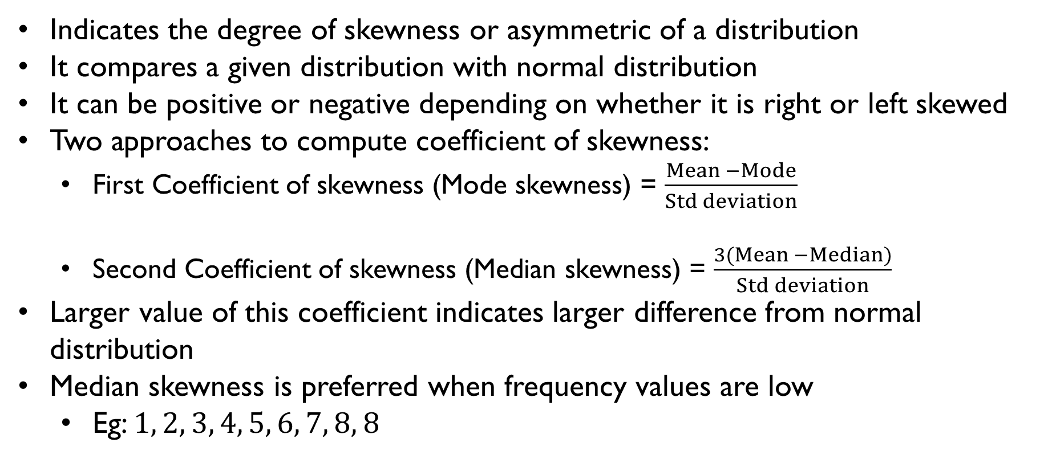
Coefficient of Skewness
Indicates the degree of skewness or asymmetric of a distribution
It compares a given distribution with normal distribution
It can be positive or negative depending on whether it is right or left skewed
Two approaches to compute coefficient of skewness:
First Coefficient of skewness (Mode skewness) = $\frac{Mean −Mode}{Std deviation}$
Second Coefficient of skewness (Median skewness) = $\frac{3(Mean −Median)}{Std deviation}$
Larger value of this coefficient indicates larger difference from normal distribution
Median skewness is preferred when frequency values are low
Eg: $1, 2, 3, 4, 5, 6, 7, 8, 8$

Slide 36
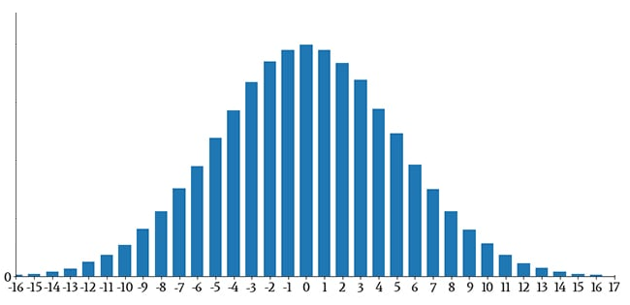
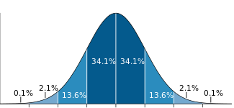







Normal Distribution
Mean = Median = Mode
A symmetric distribution centered at the mean
For a normal distribution: Mean = Median = Mode
Mean and standard deviation are sufficient to completely describe a normal distribution
For a normal distribution,
68.3% of data falls within 1 standard deviation of the mean
95.4% of data falls within 2 standard deviations of the mean
99.7% of data falls within 3 standard deviations of the mean
$$μ$$
3$σ$
2$σ$
1$σ$
1$σ$
$$2σ$$
$$3σ$$

Slide 37
Mean, Median, Mode – When to Use
Depending on Type of variable:
Continuous variable – Mean or Median
Discrete variable – Mean or Median
Categorical variable – Mode or Median (only for ordinal variable)
Depending on outliers:
Mean is sensitive to outliers while median and mode are not
Median represents centrality better when there are outliers in the data
Eg: Average value of 3 BHK property in Mumbai – Median is more indicative than mean
Depending on the shape of distribution:
For normal distribution – Mean
For skewed distribution – Median or Mode

Slide 38
Descriptive Statistics - Bivariate

Slide 39
Descriptive Statistics – Bivariate
Univariate statistics characterizes each variable in isolation
In data science, we are interested in relationship between variables
Relation between ice cream sales and temperature
Relation between weights and heights of individuals
Bivariate statistics involves chracterising two variables at once
Measures to characterize variation in one variable with respect to (w.r.t.) another:
Covariance
Correlation

Slide 40
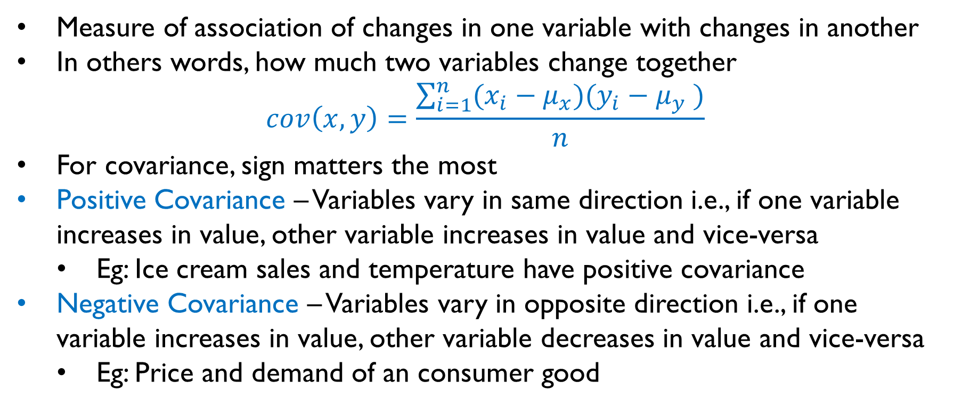
Covariance
Measure of association of changes in one variable with changes in another
In others words, how much two variables change together
$$cov\left(x,y\right)=\frac{\sum_{i=1}^{n}{(x_{i}−μ_{x})(y_{i}−μ_{y} )}}{n}$$
For covariance, sign matters the most
Positive Covariance – Variables vary in same direction i.e., if one variable increases in value, other variable increases in value and vice-versa
Eg: Ice cream sales and temperature have positive covariance
Negative Covariance – Variables vary in opposite direction i.e., if one variable increases in value, other variable decreases in value and vice-versa
Eg: Price and demand of an consumer good

Slide 41
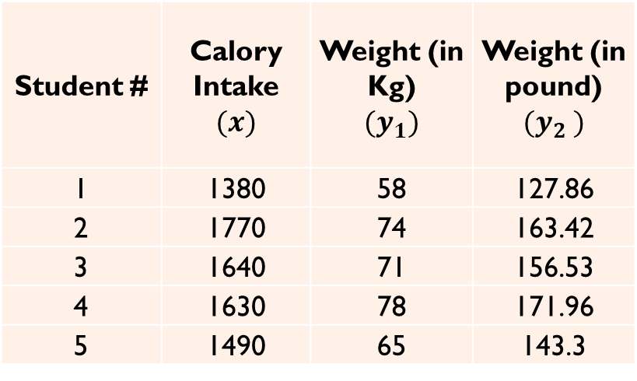
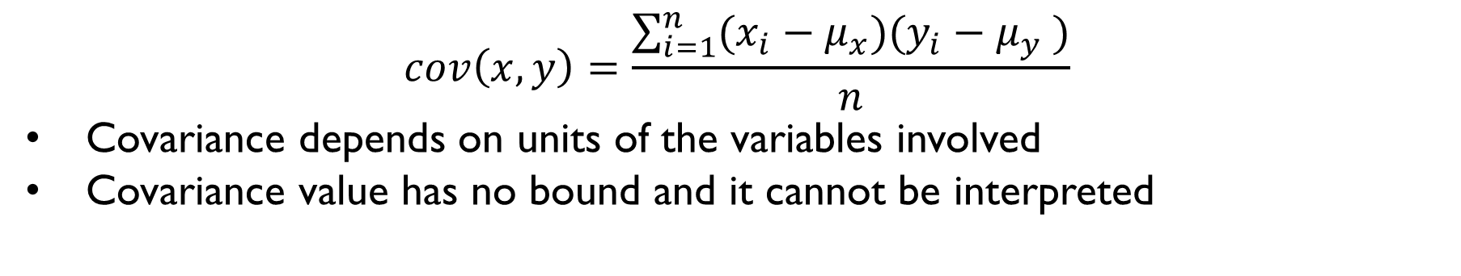
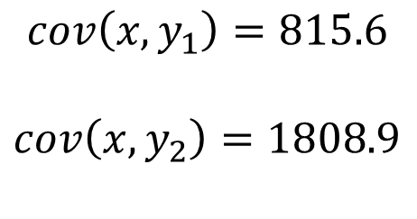
Issues with Covariance
$$cov\left(x,y\right)=\frac{\sum_{i=1}^{n}{(x_{i}−μ_{x})(y_{i}−μ_{y} )}}{n}$$
Covariance depends on units of the variables involved
Covariance value has no bound and it cannot be interpreted
Student # | Calory Intake $$(x)$$ | Weight (in Kg) $$(y_{1})$$ | Weight (in pound) $$(y_{2} )$$
1 | 1380 | 58 | 127.86
2 | 1770 | 74 | 163.42
3 | 1640 | 71 | 156.53
4 | 1630 | 78 | 171.96
5 | 1490 | 65 | 143.3
$$cov\left(x,y_{1}\right)=815.6$$
$$cov\left(x,y_{2}\right)=1808.9$$

Slide 42
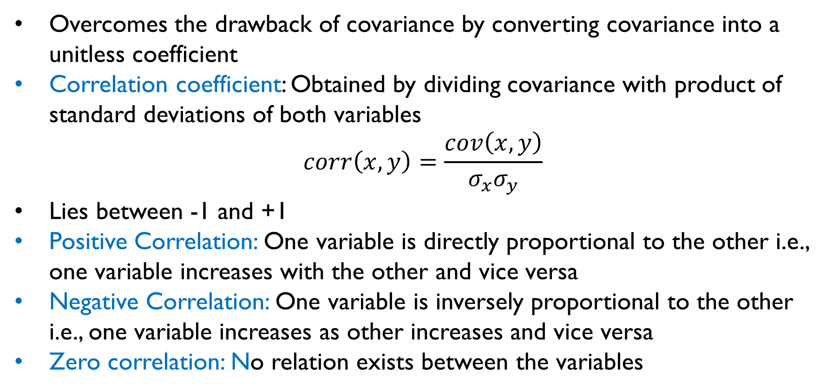
Correlation
Overcomes the drawback of covariance by converting covariance into a unitless coefficient
Correlation coefficient: Obtained by dividing covariance with product of standard deviations of both variables
$$corr\left(x,y\right)=\frac{cov\left(x,y\right)}{σ_{x}σ_{y}}$$
Lies between -1 and +1
Positive Correlation: One variable is directly proportional to the other i.e., one variable increases with the other and vice versa
Negative Correlation: One variable is inversely proportional to the other i.e., one variable increases as other increases and vice versa
Zero correlation: No relation exists between the variables

Slide 43
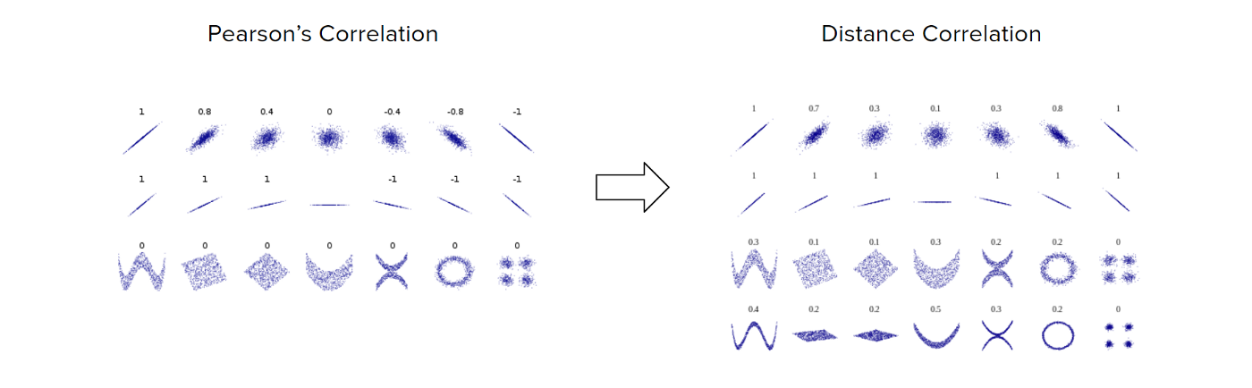
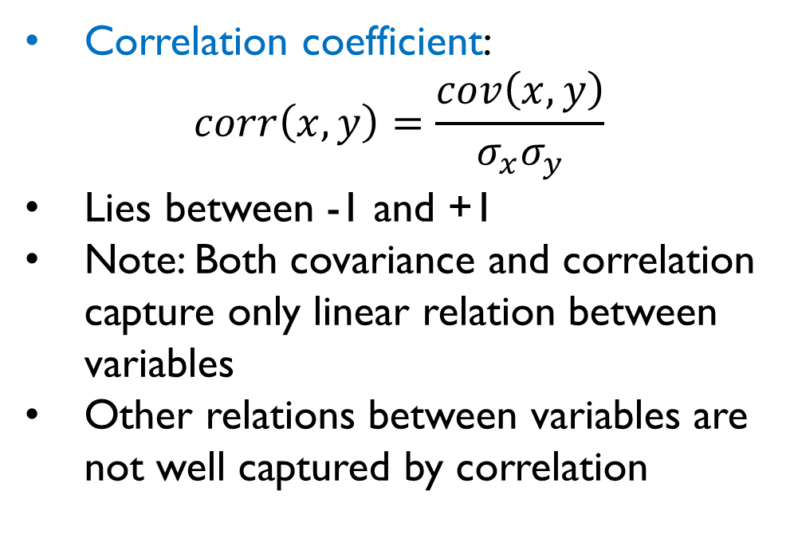
Correlation Coefficient Interpretation
Correlation coefficient:
$$corr\left(x,y\right)=\frac{cov\left(x,y\right)}{σ_{x}σ_{y}}$$
Lies between -1 and +1
Note: Both covariance and correlation capture only linear relation between variables
Other relations between variables are not well captured by correlation
Scatter plots of pairs of variables
and their correlation coefficients
Image Source: Medium.com

Slide 44
Outlier Detection

Slide 45
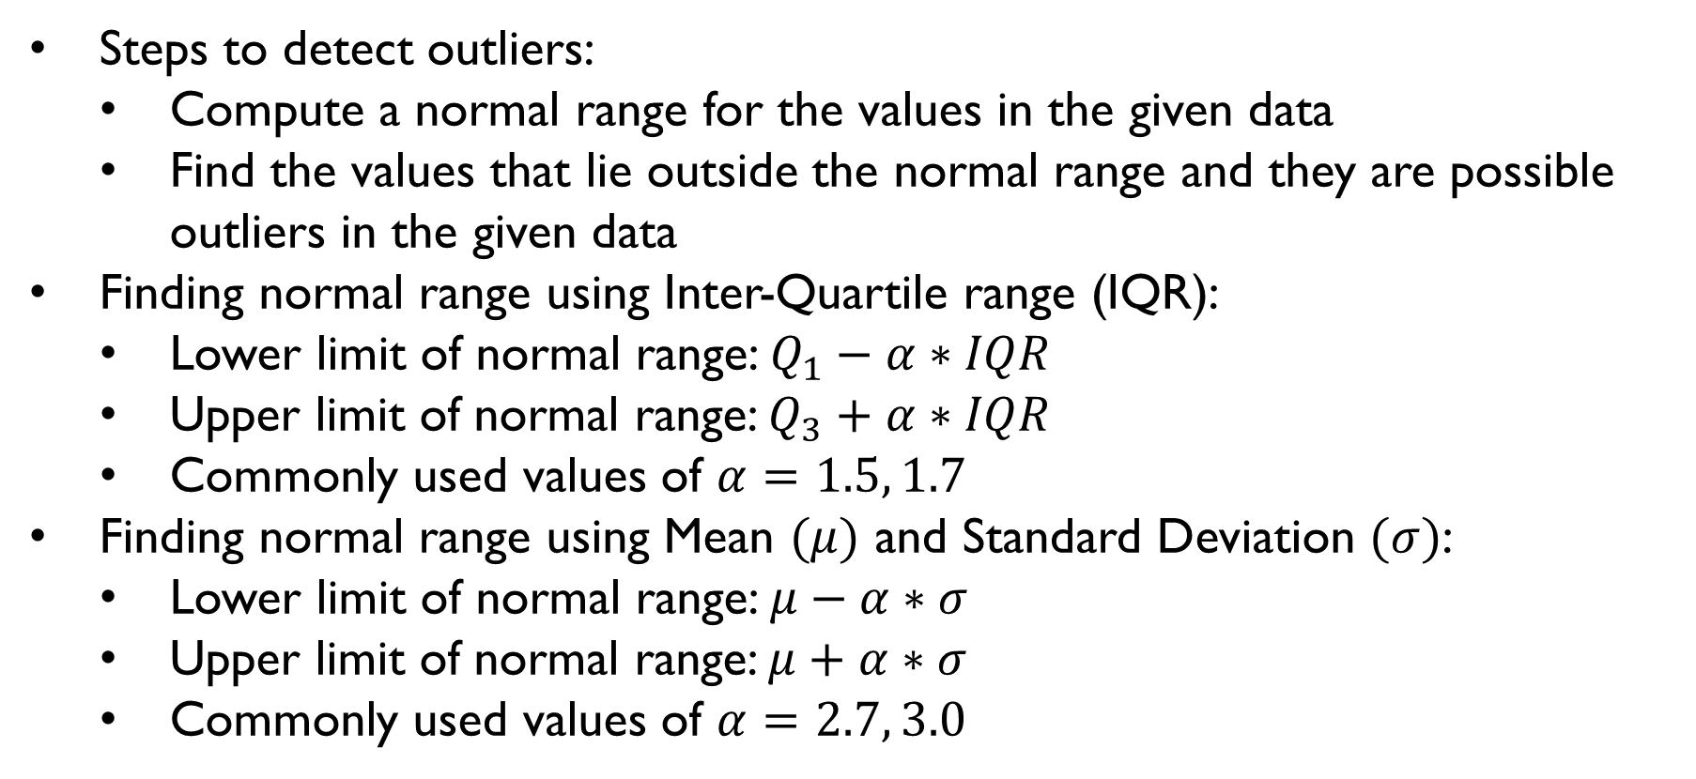
Outlier Detection
Steps to detect outliers:
Compute a normal range for the values in the given data
Find the values that lie outside the normal range and they are possible outliers in the given data
Finding normal range using Inter-Quartile range (IQR):
Lower limit of normal range: $Q_{1}−α∗IQR$
Upper limit of normal range: $Q_{3}+α∗IQR$
Commonly used values of $α=1.5, 1.7$
Finding normal range using Mean $(μ)$ and Standard Deviation $(σ)$:
Lower limit of normal range: $μ−α∗σ$
Upper limit of normal range: $μ+α∗σ$
Commonly used values of $α=2.7, 3.0$

Slide 46
Summary
Descriptive statistics involves study of characteristics of a given dataset
Dataset is characterised using:
Distribution of the data
Measures of Central Location – Mean, Median and Mode
Measures of Dispersion/Variability – Range, Inter-quartile range, variance, standard deviation, coefficients of variation and skewness
Normal distribution is most used symmetric distribution which is completely characterised by mean and standard deviation
Covariance and Correlation are used to compare the variation in one distribution with respect to another

Slide 47

THANK YOU

